Slide 1


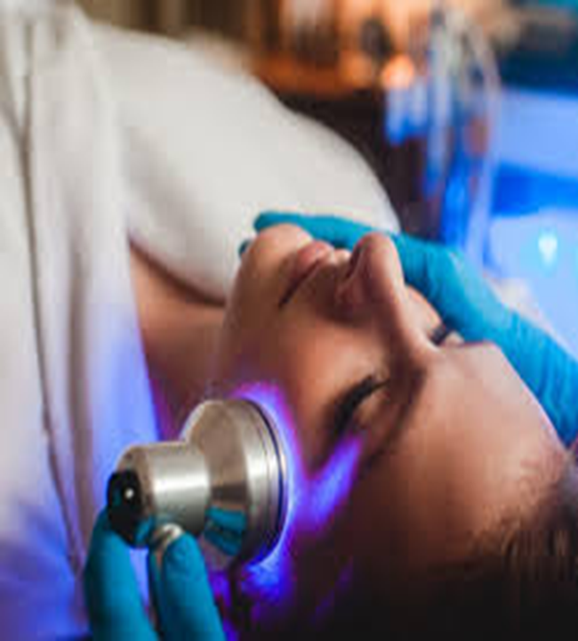
Medical physics first year
L12
Light in medicine
By Assistants professor
Dr.Mohammed Ali Jaber
Physiology Department
College of Medicine
University of Basrah

Slide 2
Objectives
By the end of this section, the student learning about :
What is Light?
The properties of light
The index of refraction.
Snell's Law
Applications of visible light in medicine
Applications of UV in medicine
Applications of IR in medicine
Applications of Fluorescence

Slide 3
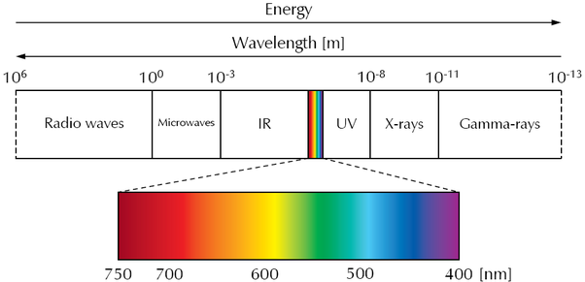
What is Light?
Light is part of the electromagnetic spectrum,
The units of light is : micrometer( µ) =10⁻⁶ m
angstrom (Å) =10⁻⁸ m
Nanometer(nm) = 10⁻⁹ m
Type of measurement
Photometric units to measured Visible light
Radiometric units to measured UV and IR radiation

Slide 4
The properties of light :
Light is Transverse wave, has some interesting properties:
The energy of light is related to its frequency and velocity as follows:
E = hν = hC/λ
where E = energy ,
h = Planck's constant, 6.62517 x 10-27 erg.sec
ν= frequency ,
C = velocity of light = 2.99793 x 10¹⁰ cm/sec
λ = wavelength
Note that from the equation given above-
C = λν
Light cannot travel faster than this

Slide 5
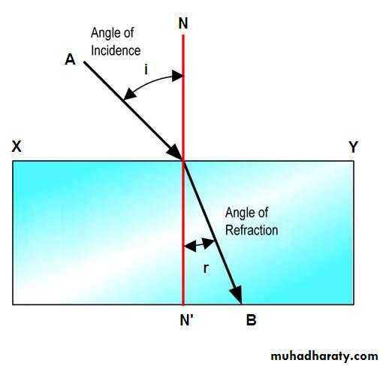
The index of refraction. C = λν
n = C/C_{m}
Note that the value of refractive index will always be greater than 1.0, since C_{m} can never be greater than C.

Slide 6
C_{m} depends on the density of the material,
C_{m} decreasing with increasing density.
Thus, higher density materials will have higher refractive indices.
The refractive index depends on the wavelength of light (λ )
Because different wavelengths are interfered with to different extents by the atoms that make up the material.
n ∝ λ

Slide 7
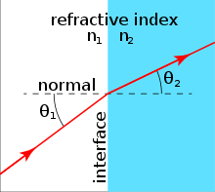
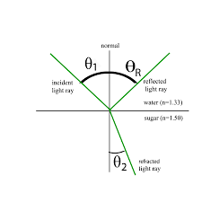
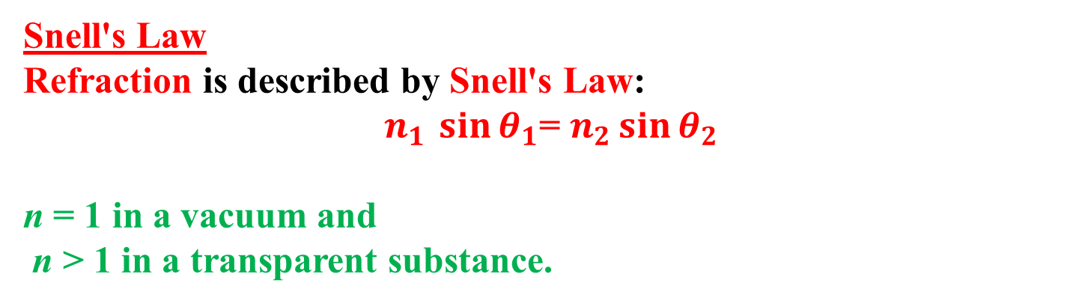
Snell's Law
Refraction is described by Snell's Law:
$n_{1 }\sin{θ_{1}}$= $n_{2}\sin{θ_{2}}$
n = 1 in a vacuum and
n > 1 in a transparent substance.
The refracted angle may be larger or smaller than the incident angle
The incident angle and the reflected angle are equal.

Slide 8
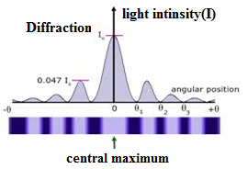
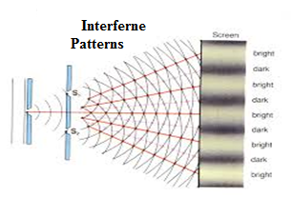
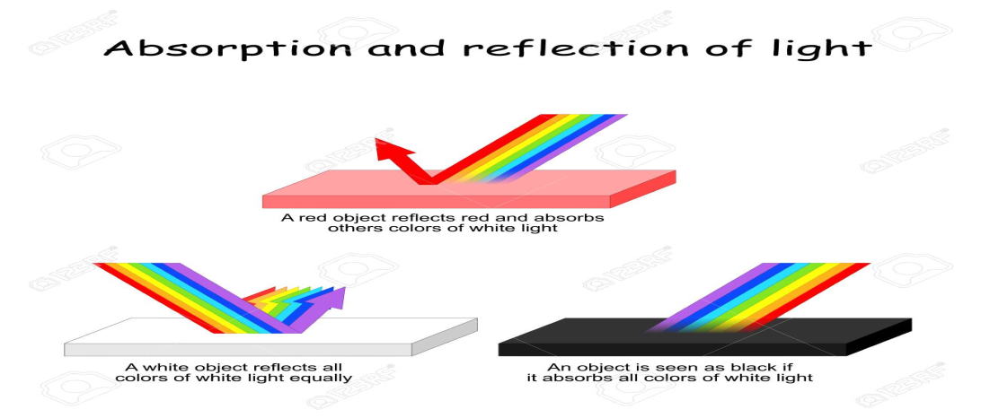
2. Behaviors of Light
Light behaves both as a wave and as a particle
As a wave interference and diffraction ,
As a particle it can be absorbed by a single molecule.

Slide 9
When a light photon is absorbed its energy is used in a various ways.
Cause A chemical change in the molecule Cause an electrical change (as in a sensitive cells of the retina) .
The chemical point of the retina triggers an electrical signal to the brain

Slide 10
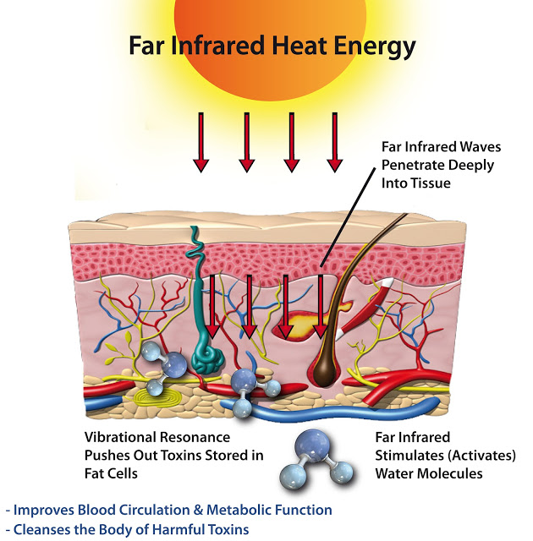
The use IR light to heat tissues.

Slide 11
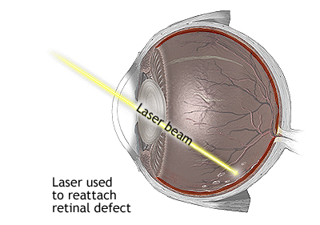
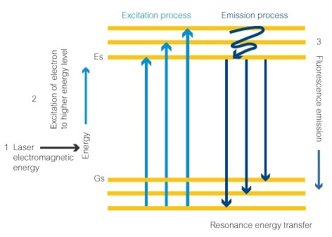
Laser beams is used to weld a detached retina to the back of eyeball and to coagulate small blood vessels in retina.
When a light photon is absorbed, a lower energy light photon is emitted. Fluorescence.

Slide 12
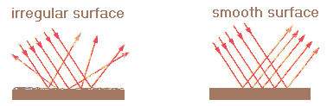
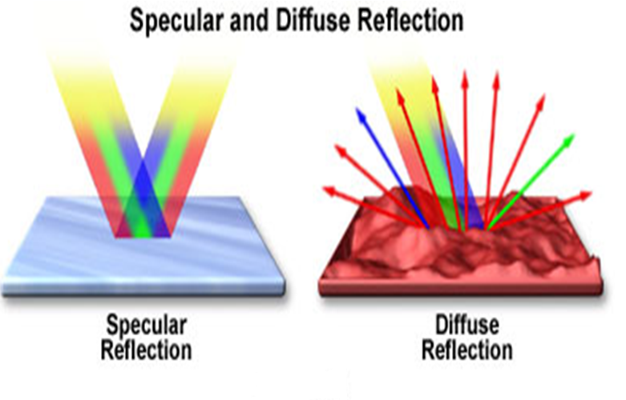
3. light is reflected to some extent from all surfaces. There are two types of reflection.
Diffuse reflection
Specular reflection

Slide 13
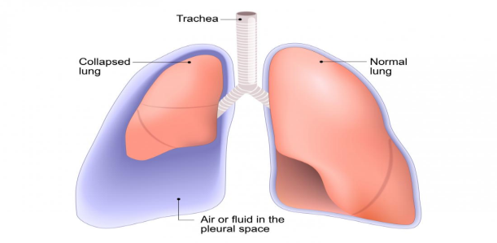
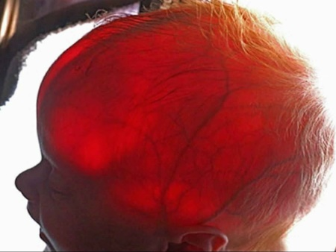
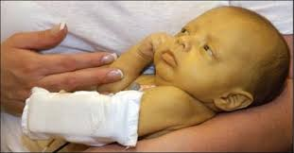
Applications and some effect of light
Applications of visible light in medicine
To permit the physician to obtain visual information
Shine light into the bodies of infants
Collapsed lung
Water – head
2. Light therapy or phototherapy consists of exposure to daylight
visible light for treating jaundice

Slide 14
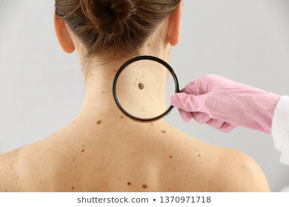
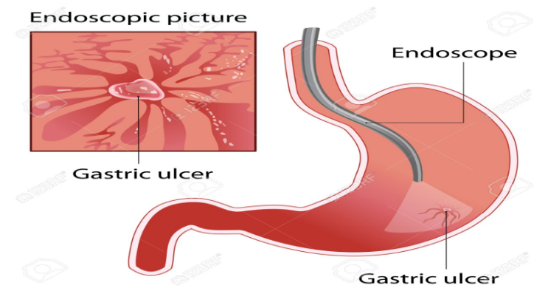
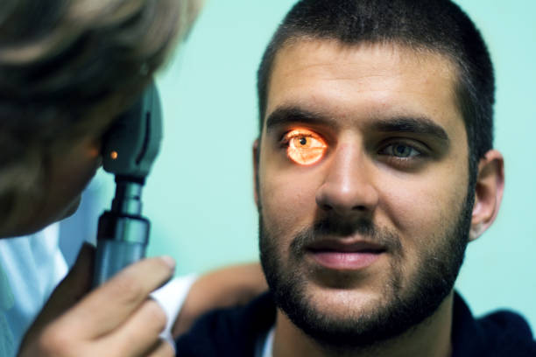
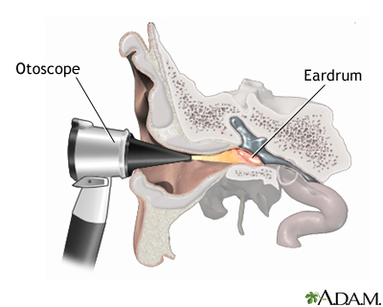
Endoscope
Normal light to examine the skin
Ophthalmoscope for looking into eyes
the otoscope for looking into ears

Slide 15
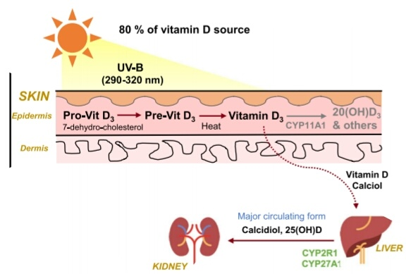
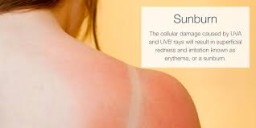
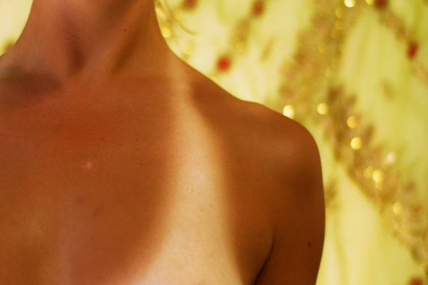
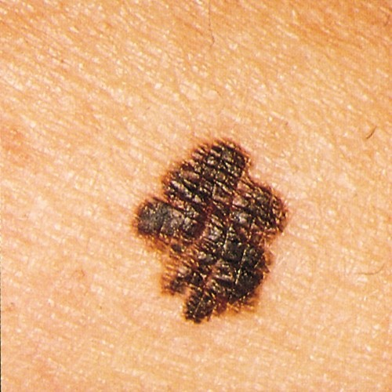
Applications of UV in medicine
Conversion of molecular products in the skin into vitamin D
UV light from the sun effects the melanin in the skin
Tanning
Solar UV is also the major cause of skin cancer in humans

Slide 16
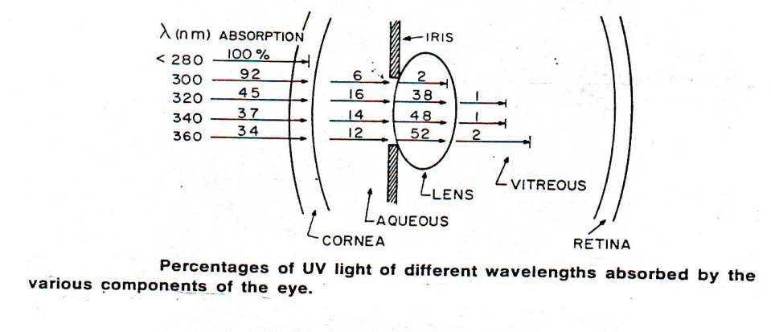
UV light cannot be seen by the eye because it is absorbed before it reaches the retina.
The ultraviolet light used to kill microorganisms.
The medical industry uses ultraviolet light to sterilize rooms, equipment and medical instruments.
It is also used as a medical treatment.

Slide 17
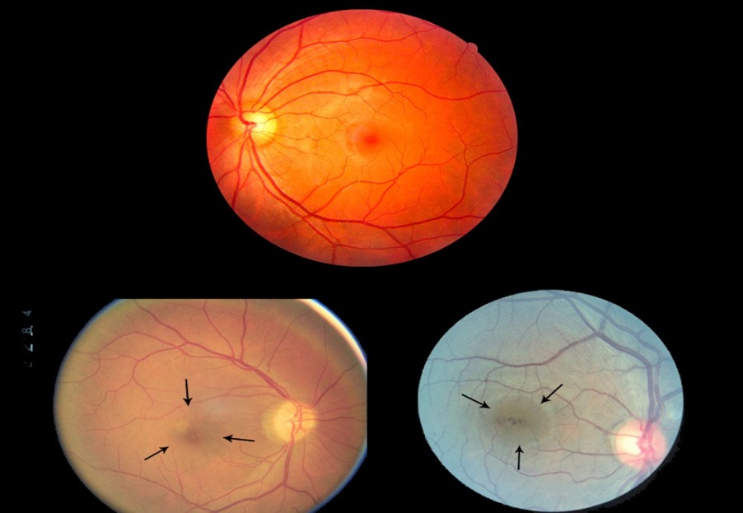
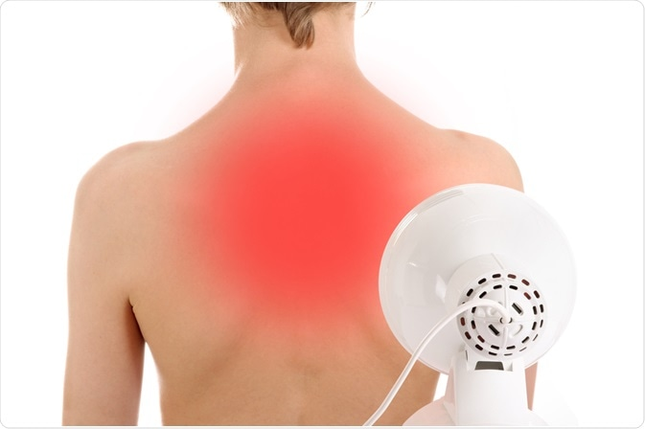
Applications of IR in medicine
When the people looking at the sun during a solar eclipse they have damaged their eye.
IR light with wavelengths of 1000 to 2000 nm are often used for physical therapy purposes

Slide 18
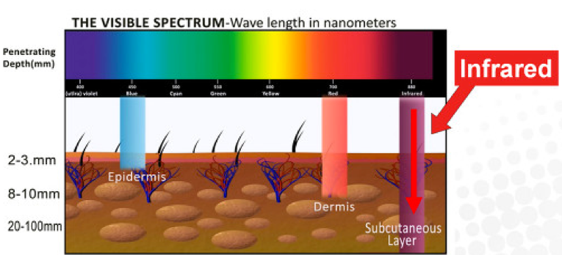
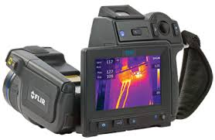
IR light penetrates further into the tissues than visible light and thus is better able to heat deep tissues.
Infrared thermal-imaging cameras are used to detect heat loss in insulated systems, to observe changing blood flow in the skin,

Slide 19
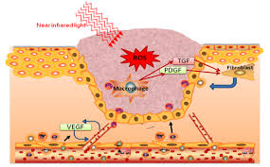
Near-infrared light, or photobiomodulation, is used for treatment of chemotherapy-induced oral ulceration as well as wound healing.
Strong infrared radiation in certain industry high-heat settings may be hazardous to the eyes, resulting in damage or blindness to the user.

Slide 20
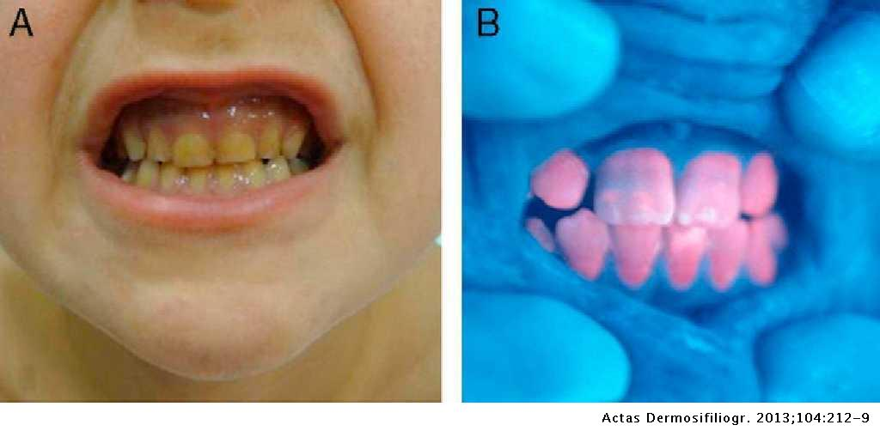
Applications of Fluorescence
Detection of porphyria, a condition in which the teeth fluoresce red when irradiated with UV light

Slide 21
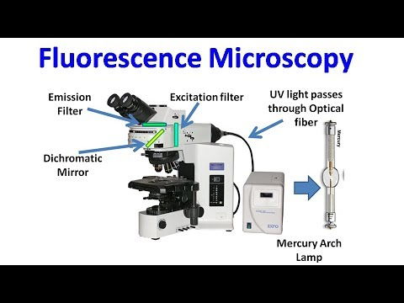
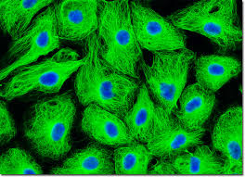
Fluorescent microscopes
To identify structures in fixed and live biological samples.
Fluorescence microscopy is a common tool for today’s life science research because it allows the use of multicolor staining, labeling of structures within cells, and the measurement of the physiological state of a cell.

Slide 22


